Slide 1




Lifespan Health May Meeting
AI Workshop
21st May 2025
AI-Driven Identification of Symptom Clusters
A Case Study in Long Covid Pattern Recognition
Jasmyn Gooding
PhD Researcher in Computer Science
MED Research Coordinator

Slide 2

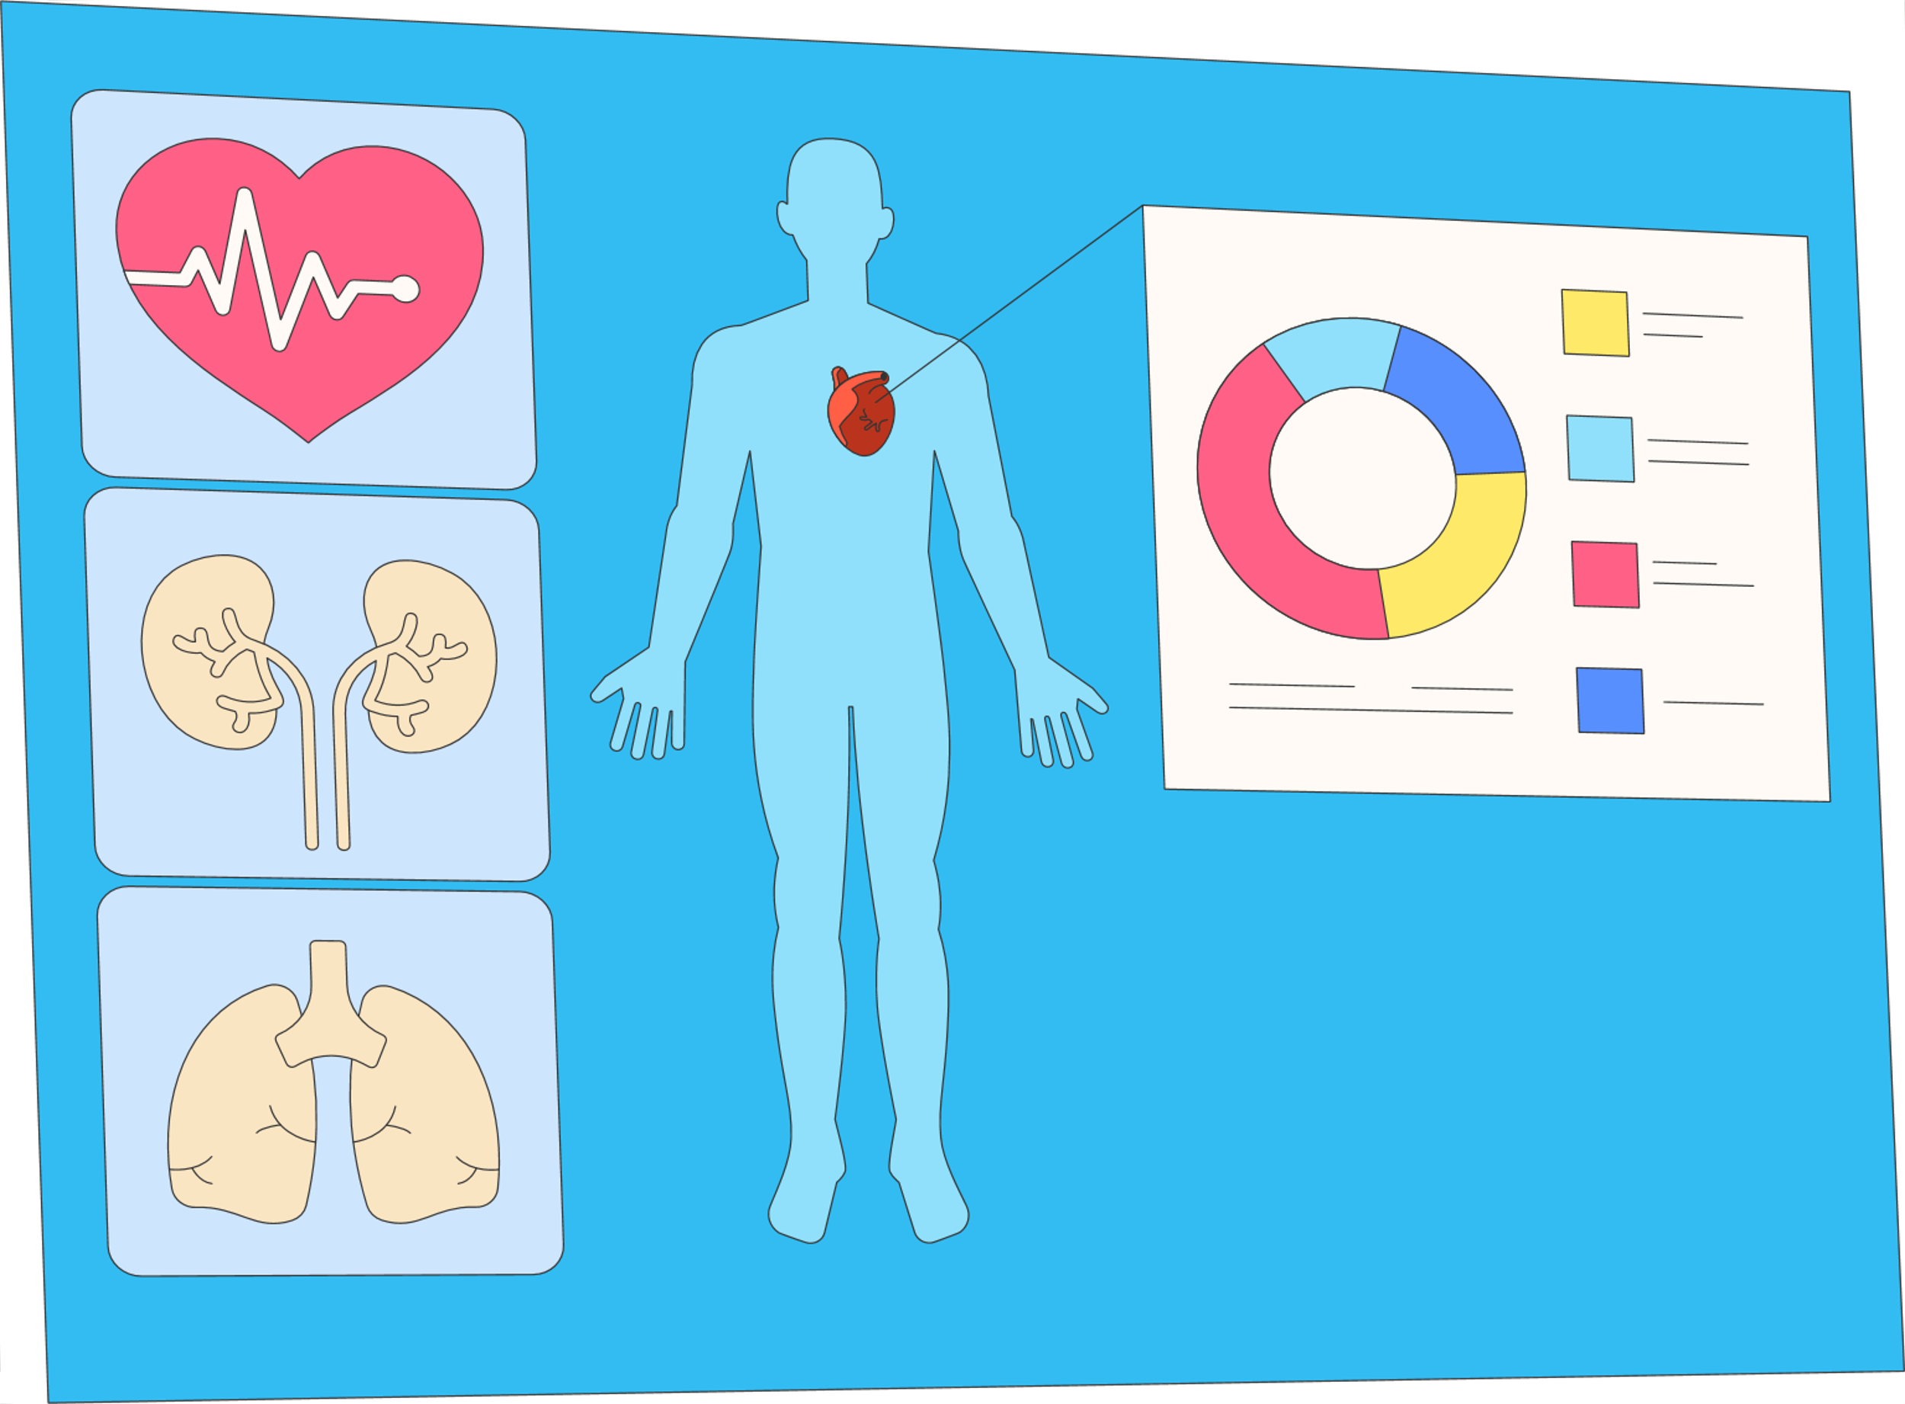


Pattern recognition
Helps uncover hidden structures in complex data by grouping similar features or behaviors—essential for understanding conditions that lack clear-cut diagnostic markers.
Symptoms like fatigue, brain fog, and palpitations are non-specific and overlap with multiple conditions, complicating traditional diagnostics.
Can AI help make sense of complex symptom data?

Slide 3
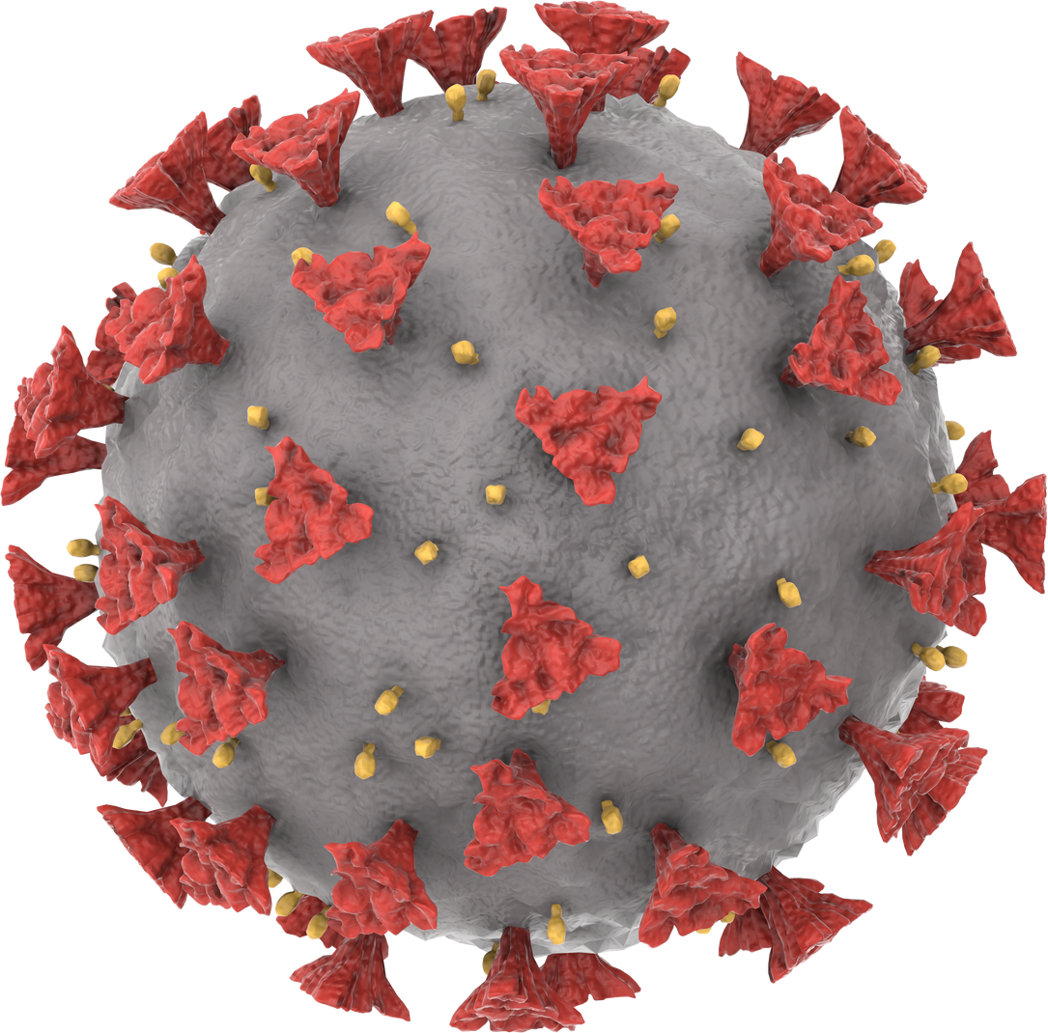
Clinical burden and diagnostic ambiguity
Clinical burden: Long Covid leads to frequent healthcare visits, extensive testing, and prolonged disability, straining both patients and healthcare systems.
Diagnostic ambiguity: The absence of definitive biomarkers and overlapping symptoms with other conditions make accurate diagnosis and treatment planning difficult

Slide 4

The Challenge for Clinicians
Fragmented care pathways: Patients often see multiple specialists, leading to siloed assessments and delayed recognition of symptom patterns
Time and data constraints: Clinicians must make sense of complex, evolving symptoms within limited consultation time and often without comprehensive data integration tools.

Slide 5
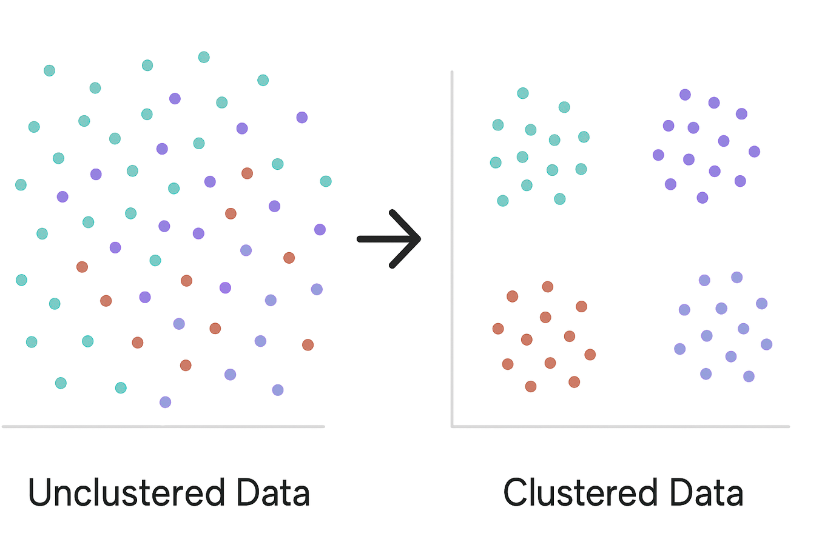
How to use AI?
Introducing Clustering:

Slide 6
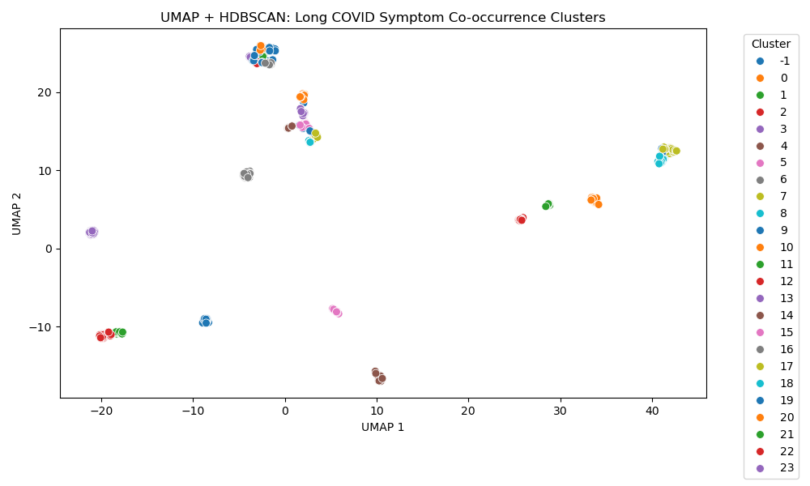
Input
Next Steps:
Determining what these clustered represent
Adding Demographic Information
Mapping to covid Strain
Self Reported Symptoms (Co-occurences, longitudinally)

Slide 7
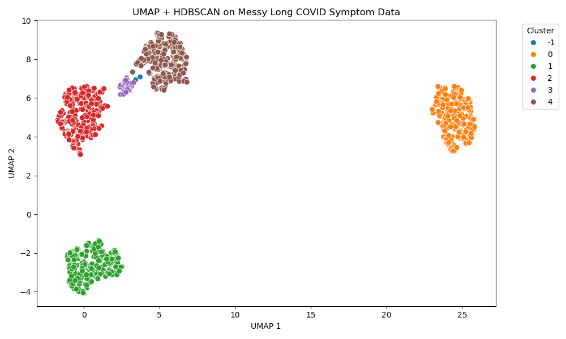
Input
Neurocognitive-dominant
Cardiopulmonary-autonomic
GI-dysautonomic
Fatigue-predominant with mood overlap
Self Reported Symptoms
Impactt
Subtype identification
Toward diagnostic criteria
Personalised interventions

Slide 8
Task (Group 1)
Discussion:
Compare and interpret the clusters
How many distinct groups emerge?
What symptom profiles define them?
How might they map to clinical care needs?
How could you use clustering in your work?
Assigned one of five synthetic datasets, each simulating patient-reported Long Covid symptoms.
Each dataset contains randomly assigned symptom patterns.
Use UMAP to reduce dimensionality and visually explore potential cluster structure in the data.
Apply HDBSCAN to perform unsupervised clustering and identify distinct symptom-based subgroups.

